Slide 1
Introduction to phases of compiler
Dr. Jagadeesh Kakarla
Assistant Professor
IIITDM Kancheepuram

Slide 2
A compiler is a program that translates source code written in a high-level programming language into a lower-level language, typically machine code, which can be executed by a computer's hardware.
The compilation process is divided into several phases, each responsible for a specific aspect of the translation.
Lexical Analysis
Syntax Analysis
Semantic Analysis
Intermediate Code Generation
Code Optimization
Target Code Generator

Slide 3
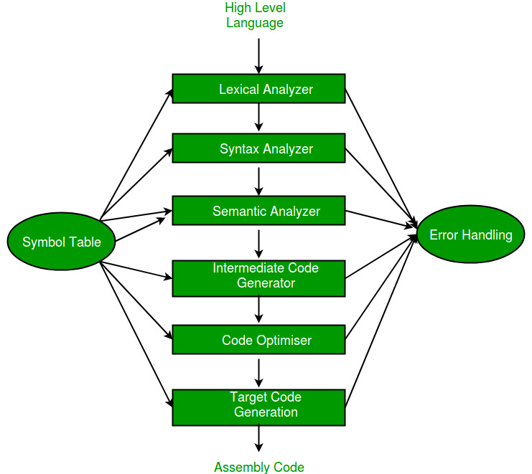

Slide 4
Lexical Analysis:
The lexical analysis phase reads the source code and converts it into a sequence of tokens.
The primary job of the lexical analyzer is to identify tokens in the source code.
A token is a sequence of characters that represent the smallest unit of meaning in the code, such as keywords (if, while, return), identifiers (variable names, function names), literals (numbers, strings), operators (+, -, *), and delimiters (;, {}, ()).
Example:
Source Code: int count = 10; Tokens: int, count, =, 10, ;

Slide 5
The lexer uses pattern recognition based on regular expressions to identify different types of tokens.
Regular Expression for an identifier: [a-zA-Z_][a-zA-Z0-9_]*
During tokenization, the lexical analyzer usually ignores whitespaces (spaces, tabs, and newlines) and comments, as they are not meaningful for the execution of the program.
Source Code: int x = 5; // This is a comment
Tokens: int, x, =, 5, ;
The lexical analyzer detects lexical errors, such as unrecognized characters, invalid token sequences, or incomplete tokens.
Example: int 3abc = 5;

Slide 6
Tools for Lexical Analysis:
Lex/Flex: These are popular tools used to generate lexical analyzers. They allow developers to define regular expressions for tokens and automatically generate the corresponding lexer in C or C++.

Slide 7
int main()
{
int x,a=2,b=3,c=5;
x=a+b*c
printf("The value of x is %d",x);
return 0;
}

Slide 8
int main()
{
int i;
for(i=0;i<5;i++)
{
int i=102;
printf("The i value is %d\n",i);
i++;
}
return 0; }

Slide 9
main()
{
int x==10,y<=10;
prinf("%d",x);
}

Slide 10
int x=4; / * hi */
X===y /*a+b*c */ *abcd */
int **p;
X=*P ++ ++ + y;
char ch=“Hello;

